Slide 1
Compilation (Synthesis Phase)
Gaurav Ghansham Dumre

Slide 2
Synthesis Phase:
Intermediate Code Generation
Code Optimization
Target Code Generation

Slide 3
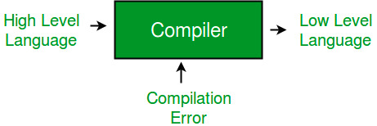
What is Compiler?
Compiler is a software that translates the source code of a high-level language into assembly language.
Phases of a Compiler,
  Analysis Phase
  Synthesis Phase

Slide 4
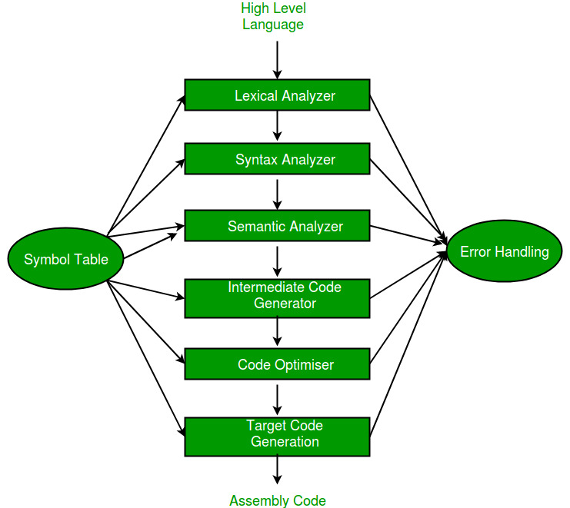

Slide 5
Compiler Synthesis:
Synthesis phase of compilation generates the target program with the help of symbol table.
It consists of,
  Intermediate Code Generation
  Code Optimization
  Target Code Generation

Slide 6
Intermediate Code Generation:
In this phase of compiler, compiler translates a source program into an intermediate code and then back end of compiler generates the target code.
Commonly used intermediate code representation,
  Asynchronous Syntax Tree
  Polish Notation
  Three Address Code

Slide 7
Three Address Code:
In TAC, every expression is divided into the sub-expression.
In TAC, there is at most one operator on one side of an instruction with two operator and the result stored in temporary variable.
Eg:- x + (y * z)
Converted into,
  t1 = y * z
  t2 = x + t1

Slide 8
Three Address Code:
The ways of representing TAC,
  Quadruples
  Triples
  Indirect Triple

Slide 9
Quadruples:
It is structure with four fields. In which result is stored in temporary variable generated by the compiler.
Expression: a = (b * – c) + (b * – c)
Converted into,
  t1 = uminus c
  t2 = b * t1
  t3 = uminus c
  t4 = b * t3
  t5 = t2 + t4
  a = t5

Slide 10
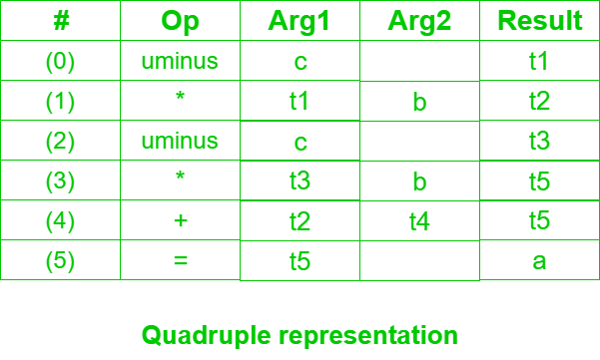
Quadruple:

Slide 11
Triples:
It is structure with three fields. In this representation instead of temporary variable, reference is given.
Expression: a = (b * – c) + (b * – c)
Converted into,
  t1 = uminus c
  t2 = b * t1
  t3 = uminus c
  t4 = b * t3
  t5 = t2 + t4
  a = t5

Slide 12
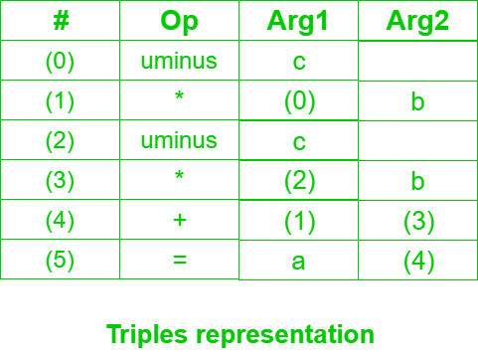
Triples:

Slide 13
Indirect Triples:
It is advancement of triples.
Expression: a = (b * – c) + (b * – c)
Converted into,
  t1 = uminus c
  t2 = b * t1
  t3 = uminus c
  t4 = b * t3
  t5 = t2 + t4
  a = t5

Slide 14
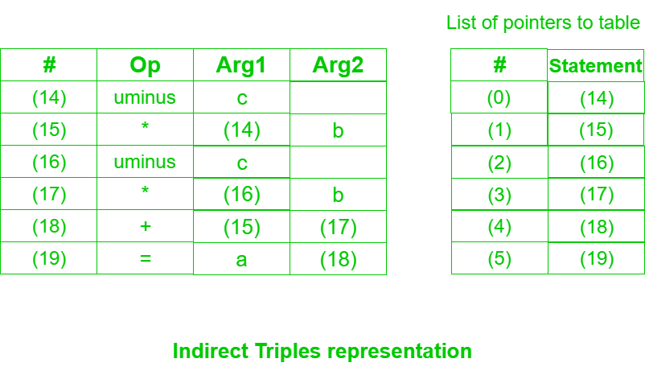
Indirect Triples:

Slide 15
Code Optimization:
It is program transformation technique, which tries to improve the intermediate code.
Optimization must be correct and must not change the meaning of the program.
Optimization should increase the speed and performance of the program.

Slide 16
Code Optimization:
Ways of code optimization,
  Variable Propagation
  Dead Code Elimination
  Compile Time Execution
  Code Motion/Movement
  Strength Reduction
  Constant Propagation
  Constant Folding
  Unreachable code

Slide 17
Code Optimization:
Variable Propagation & Dead Code Elimination:
  c = a * b; c = a * b;
  x = a ; => d = a * b + 4;
  d = x * b + 4
Constant Propagation:
  x = 12;
  y = x / 2; => y = 12 / 2;

Slide 18
Code Optimization:
Code Motion/Movement:
  Reduce evaluation frequency.
  Bring loop invariant statement out of loop.
  a = 200; a = 200;
  while(a>0) { b = x + y;
  b = x + y; => while(a>0) {
  if ((a % b) == 0) { if ((a % b) == 0) {
  printf (“%d”, a); printf (“%d”, a);
  } }
  } }

Slide 19
Code Optimization:
Strength Reduction:
  b = a * 2; => b = a + a;
Constant Folding:
  return (10 + 20); => return (30);
Unreachable code:
  return 0; => return 0;
  printf (“Value of x is %d”, x);

Slide 20
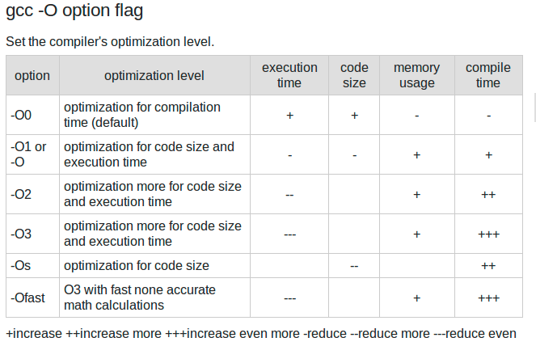
Code Optimization

Slide 21
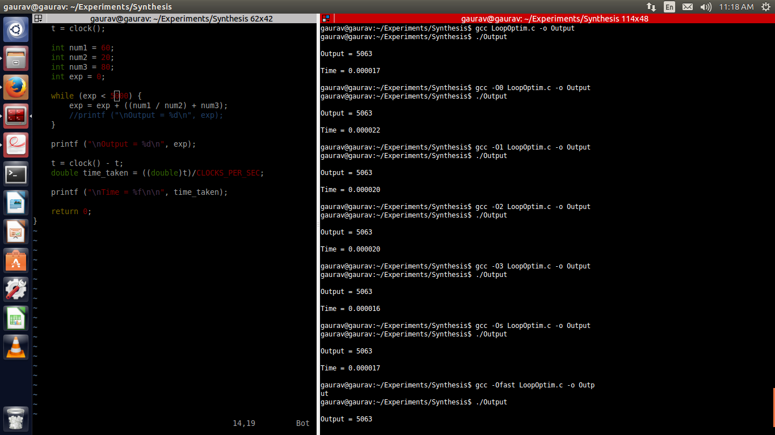
Code Optimization

Slide 22
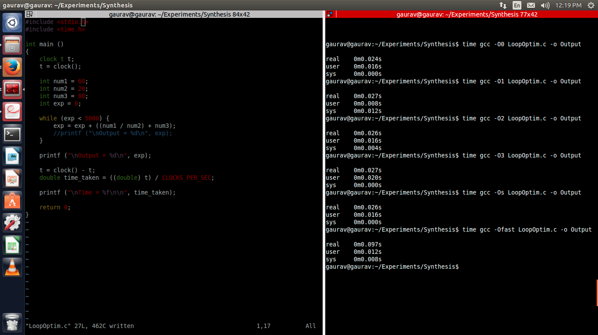
Code Optimization

Slide 23
Target Code Generation:
It converts optimized code into target machine code.
A code generator is expected to have an understanding of the target machine runtime environment and instruction.
Task of Code Generator,
  Register Allocation
  Stack Frame Layout
  Instruction Selection

